Slide 1


Slide 2
Fulbright Scholar Program Opportunities
PRESENTER NAME AND EMAIL
PRESENTER TITLE
INSTITUTE OF INTERNATIONAL EDUCATION
COUNCIL FOR INTERNATIONAL EXCHANGE OF SCHOLARS
DATE
LOCATION

Slide 3
OVERVIEW
Presentation Overview
Introduction
Core Fulbright U.S. Scholar Program
Additional Fulbright U.S. Scholar Opportunities
Fulbright Visiting Scholar Opportunities

Slide 4
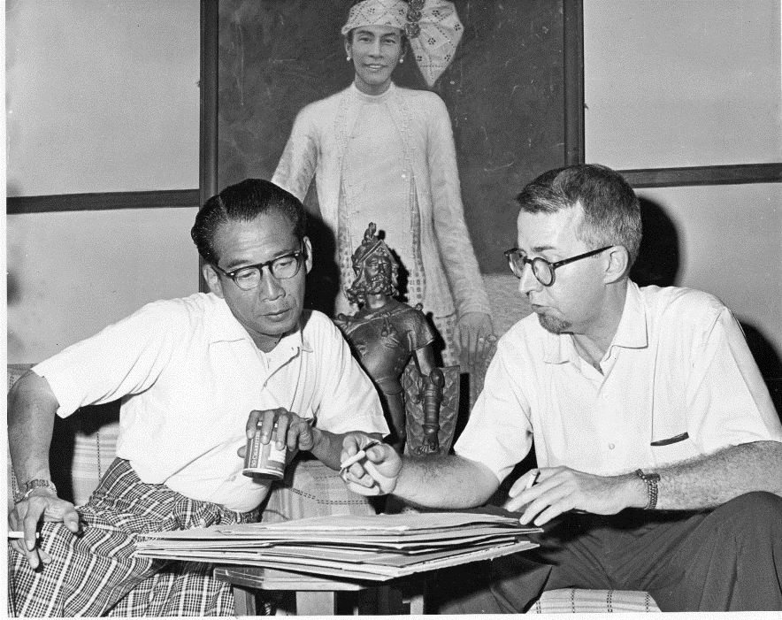

INTRODUCTION
The Fulbright Program
“We must try to expand the boundaries of human wisdom, empathy and perception, and there is no way of doing that except through education.”
— Senator J. William Fulbright
Notes:
Photo Caption: Left- Dr. Joseph Withey, Associate Professor of English, East Carolina College, Greenville, North Carolina, discussing a planned book on Burmese dancing and dramatics with Kenneth Sein, one of Burma's leading dancers, during his Fulbright Research Scholar grant from July 1960-June 1961. Right: Linda Chamerlain, Adjunct Professor at the University of Alaska and Director/Public Health Scientist, Alaska Family Violence Prevention Project, was a 2014-2016 Fulbright Arctic Scholar.

Slide 5

INTRODUCTION
The Fulbright Legacy
Established 1946 to expand and strengthen the relationships between the people of the United States and citizens of the rest of the world
Sponsored by U.S. Department of State’s Bureau of Educational and Cultural Affairs
Administered by the Institute of International Education’s Council for International Exchange of Scholars (CIES)

Slide 6


INTRODUCTION
Fulbright in Numbers
370,000+
Fulbrights awarded
since 1946
800
U.S. Scholar
grants annually
160
Participants
countries
82
Pulitzer Prize
recipients
58
Nobel
Laureates
37
Heads of State or
Government
31
MacArthur
Fellows
16
Presidential Medal of
Freedom recipients

Slide 7

INTRODUCTION
Fulbright Scholars are:

Slide 8
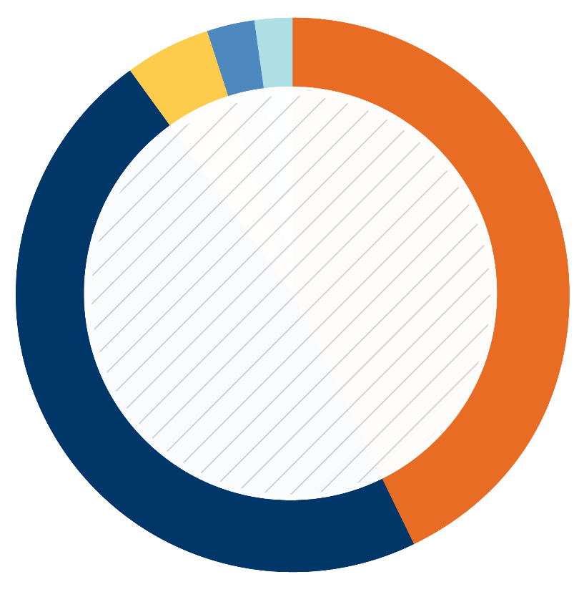
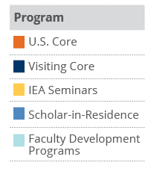
Fulbright Scholar Program
Fulbright Scholar Program Overview
2%
3%
5%
43%
2016-2017 Fulbright Scholars
47%

Slide 9
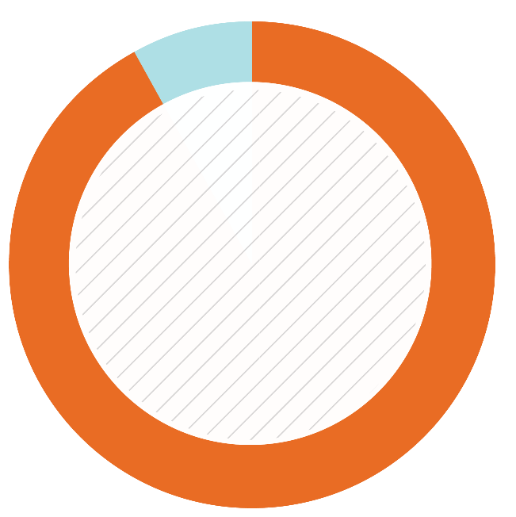
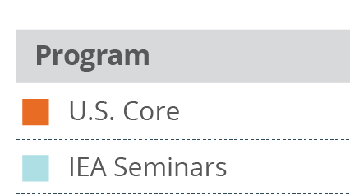
U.S. SCHOLAR PROGRAM
Fulbright U.S. Scholar Program
Core Fulbright U.S. Scholar Program
International Education Administrator Seminars
Collaborative Research
8%
92%
Percentage of U.S. Scholars
2016-2017

Slide 10
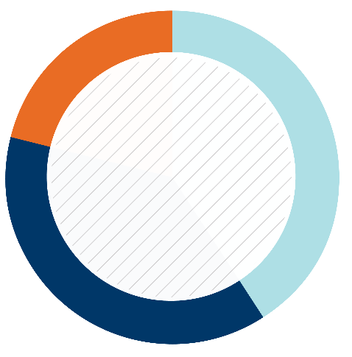
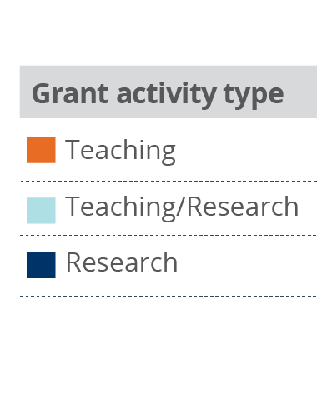
U.S. SCHOLAR PROGRAM
Core Fulbright U.S. Scholar Program
Supports teaching and/or research activity for three to 12 months
Programs active in +125 countries for faculty, administrators and professionals
Open to all disciplines
Apply to specific award with
proposed project
Application deadline: August 1
Most hosts are higher education institutions
  Eligible hosts vary by award, may include universities, research centers, institutes, laboratories, government offices, museums, etc.
21%
41%
Percentage of Scholars
2016-2017
38%

Slide 11
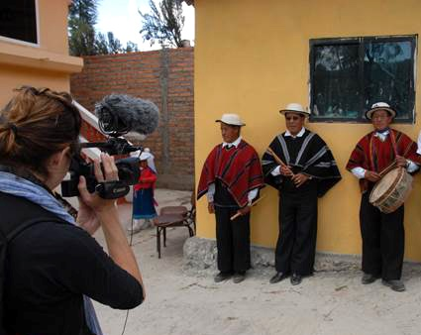
U.S. SCHOLAR PROGRAM
A Fulbright that Works for You
Time Considerations:
  Flex option
    Allows multiple visits over two years
    Available in 63 countries and 2 world
      areas
Awards throughout your career:
  Postdoctoral awards
  Early Career
  Distinguished Chair
Home university affiliation is not required, applications from artists and professionals, independent and emeriti scholars are welcomed!

Slide 12
U.S. SCHOLAR PROGRAM
Eligibility for U.S. Scholar Programs
U.S. citizenship
Degree as required by award
  Ph.D. or other terminal degree may be required
  Many awards in the Core Program are open to applicants with a Masters and professional or academic experience
Professionals and artists outside academia - recognized professional standing and substantial accomplishments
Teaching experience as required by award
New policies on previous Fulbright Scholar grants and waiting periods between grants

Slide 13

U.S. SCHOLAR PROGRAM
Core Fulbright Program Process
What do you want to do and/or where do you want to go?
Develop project and identify location
Apply
Peer Review and Selection
1
2
3
4
5

Slide 14
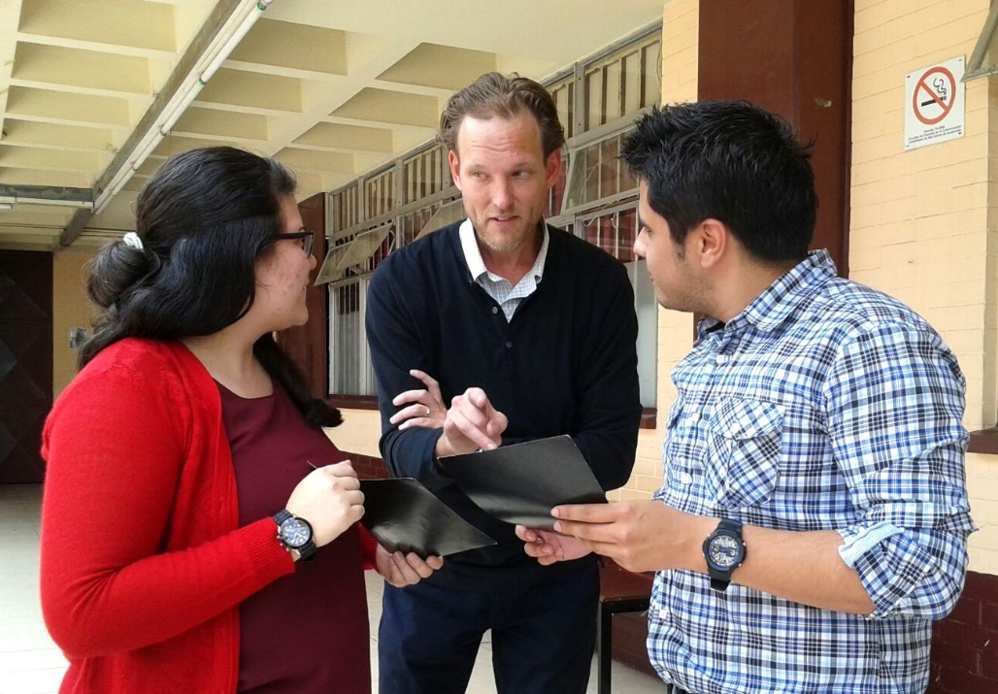
U.S. SCHOLAR PROGRAM
Application Resources
Fulbright Scholar Program website and Catalog of Awards
Application and
Application Instructions
Application Guidelines,
Project Statement Guidance
and Samples
Webinars
The Fulbright Scholar Blog
MyFulbright
Fulbright Scholar Liaisons –
  logistics
Fulbright Scholar Ambassadors – mentors
Outreach Lecturing Fund - connections

Slide 15
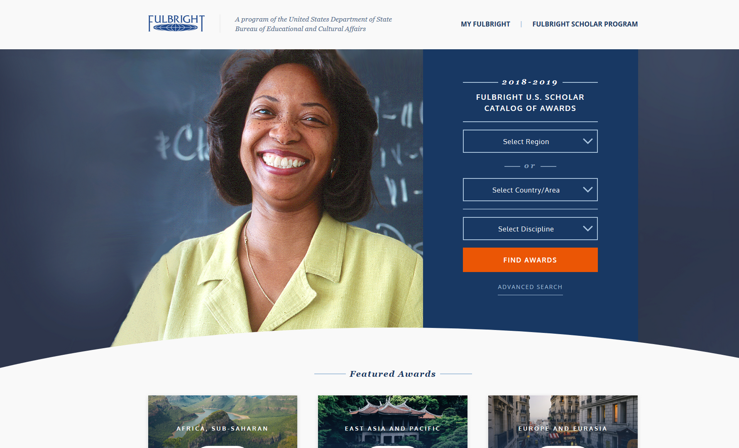
Award Catalog
Catalog Landing Page

Slide 16
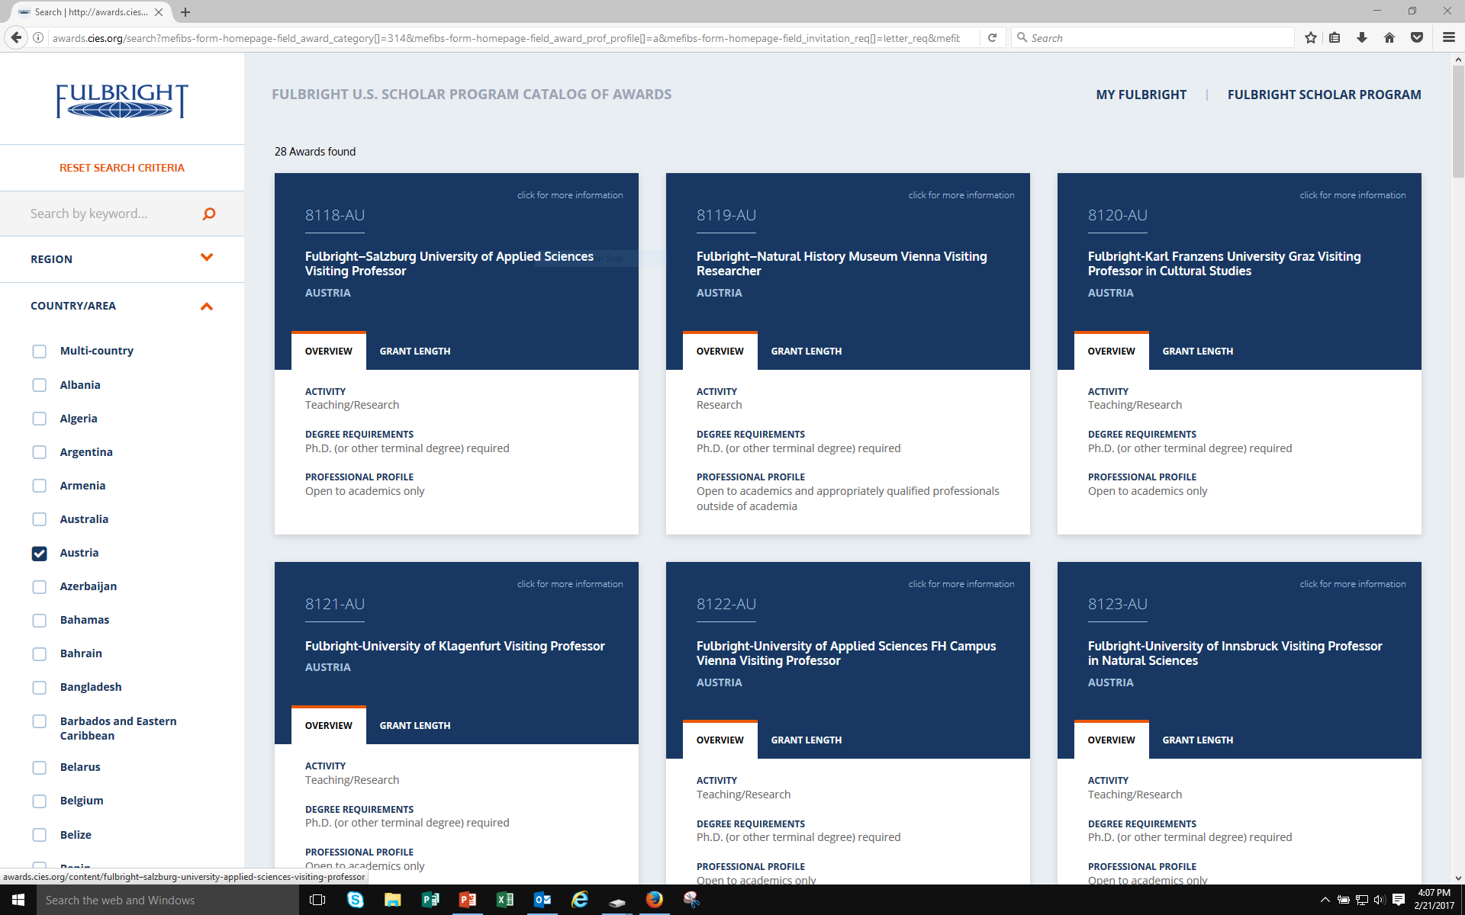
Award Catalog
Country Awards

Slide 17
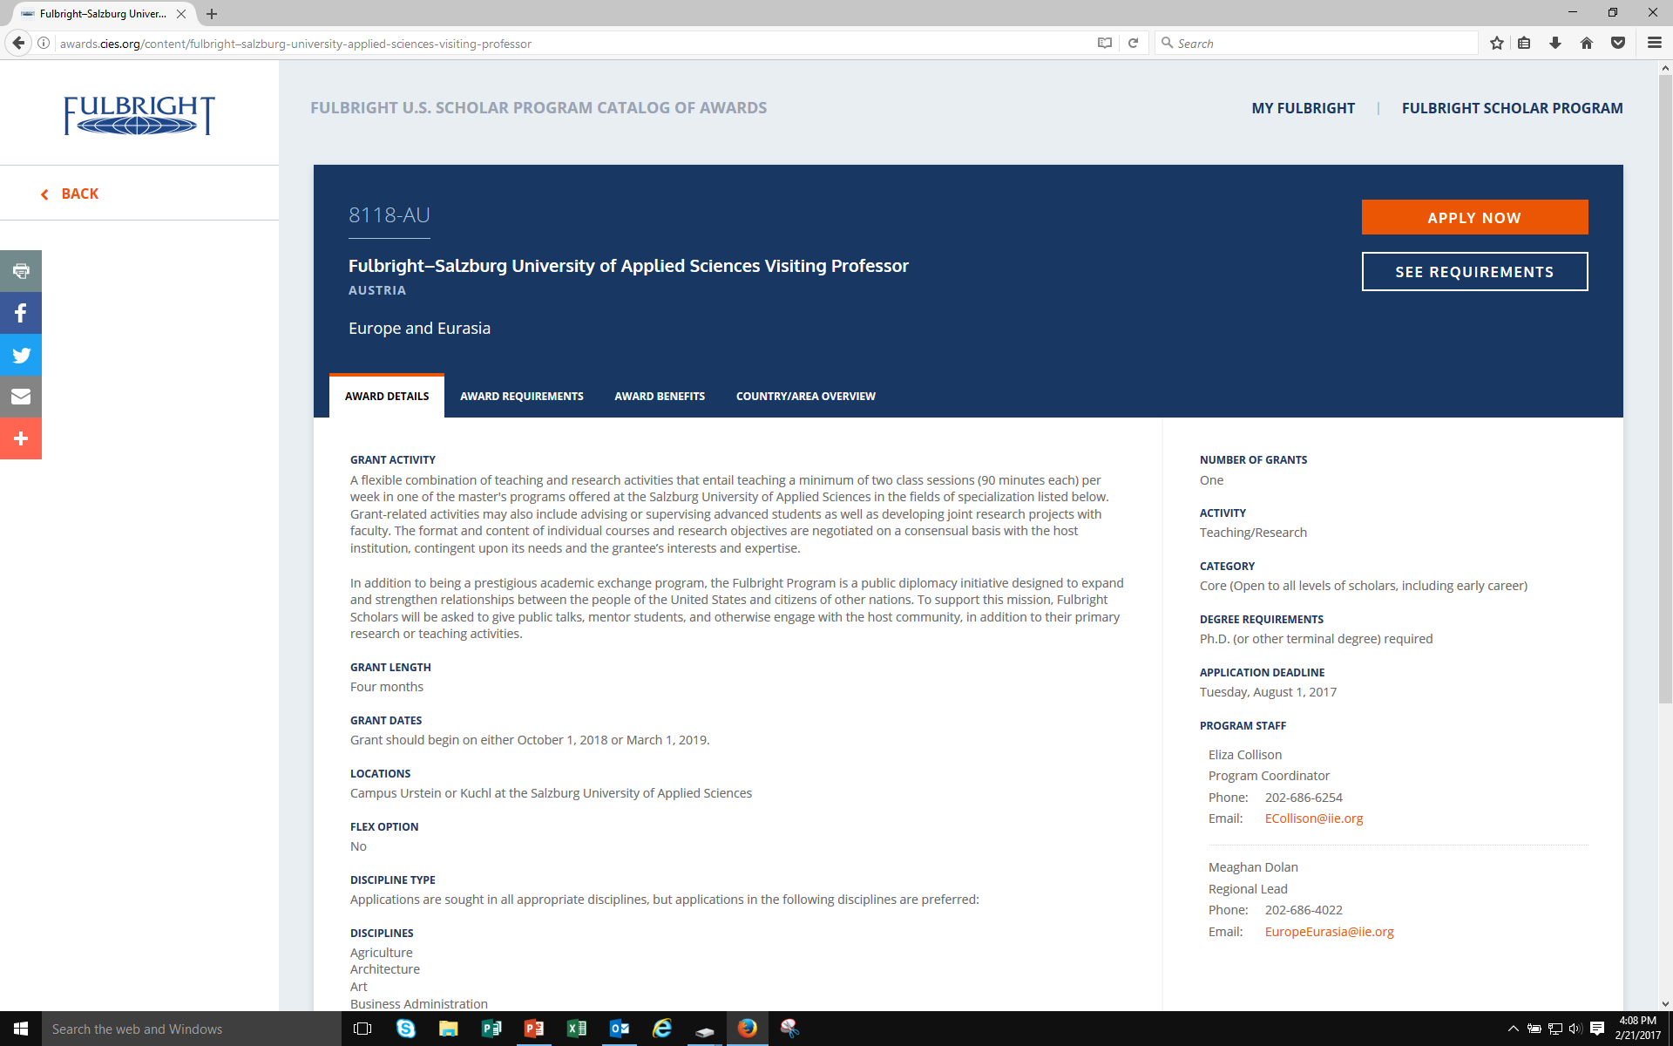
Award Catalog
Award Description

Slide 18
U.S. SCHOLAR PROGRAM
Selecting the Right Award
Match your expertise, experience and proposal to the award description
Regional experience and language ability
Discipline preferences listed in the award
Relevance of the project to the country; why will host country benefit from your project?
Career level - early career, postdoctoral, mid-level, Distinguished Chair

Slide 19
U.S. SCHOLAR PROGRAM
Fulbright Flex Awards
Flex Awards are designed for scholars who require multiple visits to the host country over short segments
Applicants must indicate plans for Flex in their project statement, including a project timeline
Flex grantees are especially encouraged to make contact with the local community, developing long-term connections and collaborations
Available in specific countries and regional awards
Consult the Catalog of Awards

Slide 20

U.S. SCHOLAR PROGRAM
Core Multi-Country Opportunities
Regional Research Programs:
  Sub-Saharan Africa
  Middle East and North Africa
  South and Central Asia
  ASEAN Region (Southeast Asia)
Cross-Strait Studies (China and
  Taiwan)
Fulbright-Carlos Rico Award for North American Studies (Canada and Mexico)
Fulbright-Schuman European Union Affairs, Austrian-Hungarian Research Award

Slide 21
U.S. SCHOLAR PROGRAM
Fulbright Global Scholar Award
Significant innovation for Fulbright
Project must include at least 2 separate world regions
Work typically in 2-3 different countries
2-3 segments over as much as 2 years
Topics must benefit from a global perspective
Specify
  Why each country
  What will be accomplished
  When each country segment is planned

Slide 22
U.S. SCHOLAR PROGRAM
Application Components
Application Form
Project Statement
Curriculum Vitae or Resume
Course Outlines or Syllabi (for teaching awards)
Select Bibliography (for research awards)
Letters of Reference
Additional Components, Depending on Award
  Language Proficiency Report
  Letter of Invitation
  Supplemental materials for applicants in the Arts, Architecture, Writing and Journalism

Slide 23
U.S. SCHOLAR PROGRAM
Affiliations and Invitations
Grant Locations:
If a host is identified, it will be found under Location
When a host is not identified, there are several resources to help find an affiliation:
  International office on your campus
  U.S. and Visiting Fulbright Scholar Directory
  Review award description for suggested hosts or resources
Letter of Invitation:
Non-binding expression of interest from proposed host abroad
Should come from person with whom you will be collaborating
Should be on host institution letterhead

Slide 24
U.S. SCHOLAR PROGRAM
Review Criteria
Applicant credentials, professional standing and accomplishments
Suitability of applicant’s training, knowledge, skills and experience, including justification if applicant has substantial prior experience in the country of application or a prior U.S. Fulbright Scholar grant
Quality of proposed project
Evidence of personal qualities, including related to cultural adaptability and sensitivity
Project’s potential impact, value of projected outcomes

Slide 25
U.S. SCHOLAR PROGRAM
Submitting a Competitive Application
Fulbright goal: promote mutual understanding
Why you are interested in a Fulbright and why in your proposed host country
Professional expertise and skills you can offer; benefits to the host institution and host country; exchange of knowledge and experience
Cultural diplomacy; demonstrated flexibility, adaptability
Outcomes, impact, and multiplier effect
  for your professional development, home campus, students, field at large; for your host institution
  future collaborations; linkages: personal, professional, institutional; plans for sustaining relationships
  internationalizing campus and curriculum

Slide 26
U.S. SCHOLAR PROGRAM
Project Statement
Your opportunity to lay out your proposed project specifics in as much detail as possible
Why Fulbright and why this country/institution/organizations?
Focus on what you plan to do; the specific courses you plan to teach/the methods and goals of your research
Outcomes from the grant - impact on hosts, home institution and you
How adaptable are you? How well will you deal with challenging situations?

Slide 27
U.S. SCHOLAR PROGRAM
Review Process and Timeline
AUG.
Program staff conduct technical reviews for completeness
SEPT.
Discipline-specific committees review applications
SEPT. –
EARLY NOV.
U.S. peer review committees discuss applications for a single geographical region
NOV. – JAN..
Applicants notified of status - Recommended applications are sent to host countries and to the J. William Fulbright Foreign Scholarship Board
FEB. – MAY
Grantees notified of final approvals
MAY – JUNE
Grant packets sent to grantees

Slide 28
U.S. SCHOLAR PROGRAM
Fulbright Impact: Personal and Professional
Increased academic production
New technical knowledge and skills
Development of intercultural communication skills
Enhanced teaching skills and new methodologies
Published research (2015 survey of 2013-2015 grantees)
  +60% of grantees published in peer reviewed journals
  39% of grantees published books or book chapters
Access to an expansive network of Fulbright alumni around the world

Slide 29
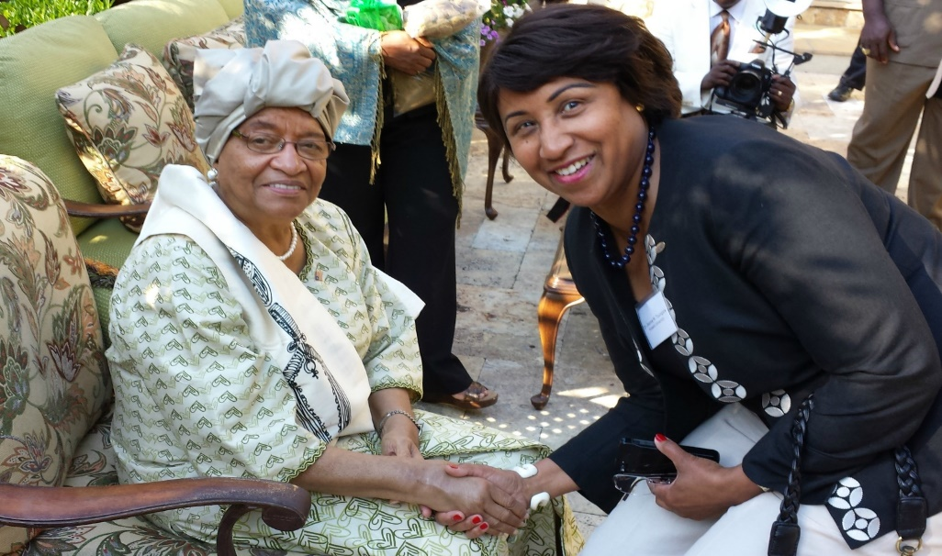
U.S. SCHOLAR PROGRAM
Fulbright Impact: Home Institution
Host institution gains new knowledge, new courses and new energy from scholar
Scholar’s collaborative relationship with host institution and colleagues in-country results in continued dialogue and exchange
Experience impacts scholar’s field, career, home institution and home community
Notes:
Photo Caption: Jeanne Toungara, Associate Professor of History at Howard University, had Fulbright-Hays award to Senegal and Côte d'Ivoire, where she researched indigenous ideologies and the cultural foundations of contemporary African politics.

Slide 30
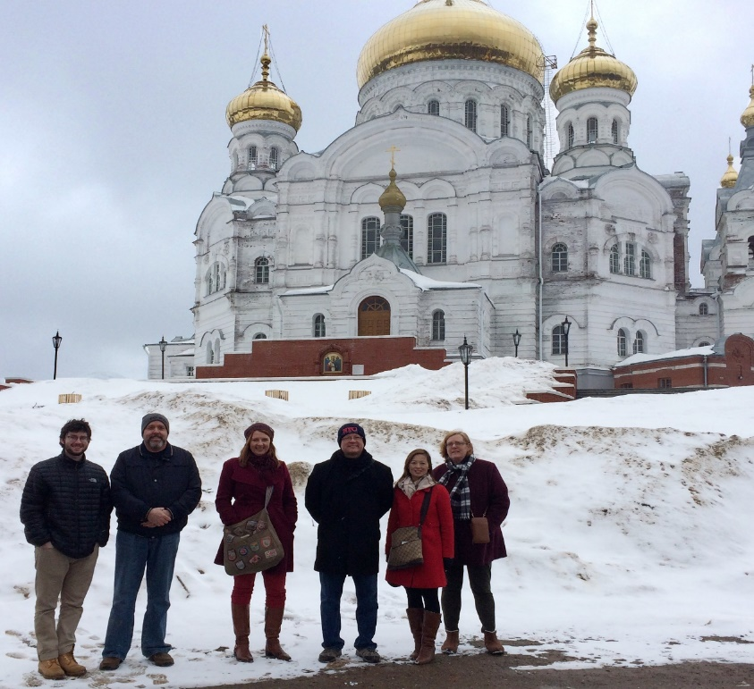
U.S. SCHOLAR PROGRAM
Administrator Seminars
International Education Administrator Seminars (IEA)
  India, Taiwan- Aug. 1
  Japan, Korea,- Nov. 1
  France, Germany- Feb. 1
Russia Community College
Administrators Seminar
  Oct. 16
  Applicants must be in community
  college administration – typically presidents, vice presidents, provosts, deans and other individuals with institutional authority for program development and international outreach
U.S. peer review committees discuss applications for a single geographical region
Notes:
Photo Caption: The 2016 Russian Community College Administrators Seminar

Slide 31

U.S. SCHOLAR PROGRAM
Collaborative Research Programs
Fulbright NEXUS Regional Scholar Program
  Fosters collaborative and multidisciplinary
  research to address Western Hemisphere
regional issues and produce tangible results
  20 American and overseas junior scholars,
  professionals and researchers
Fulbright Arctic Initiative
  Scholars, professionals and applied
  researchers from the United States, Canada,
  Denmark, Finland, Iceland, Norway, Russia
  and Sweden
  Stimulates international scientific
  collaboration on Arctic issues while increasing
  mutual understanding between people of the
  United States and the people of other countries.
Notes:
Photo Caption: Linda Chamberlain, Fulbright Arctic Initiative 2014-2016 from Finland working in the field of public health and epidemiology. Photographed with dog team in Caribou Hills, Alaska

Slide 32
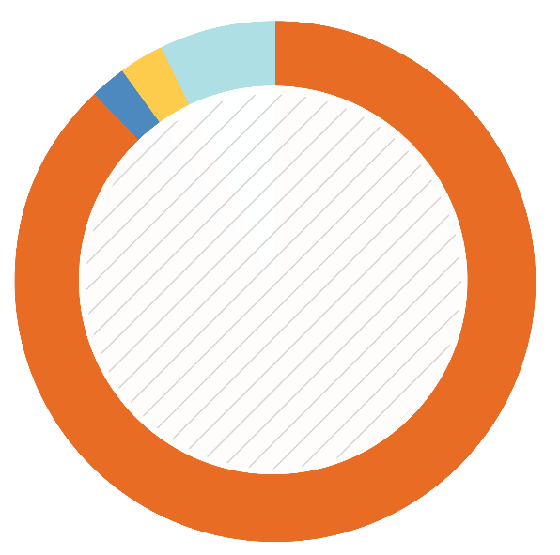
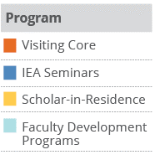
VISITING SCHOLAR PROGRAM
Visiting (Non-U.S.) Scholar Programs
Core Fulbright Visiting Scholar Program
Fulbright Scholar-In-Residence
(S-I-R) Program
Outreach Lecturing Fund (OLF)
Faculty Development Programs
Collaborative Research Programs
2%
3%
7%
Percentage
of Visiting Scholars
2016-2017
88%

Slide 33
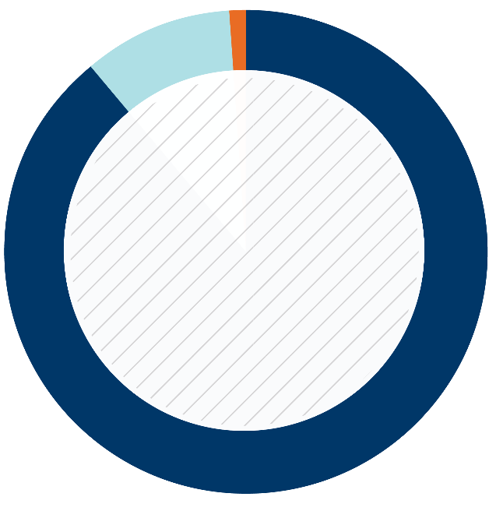
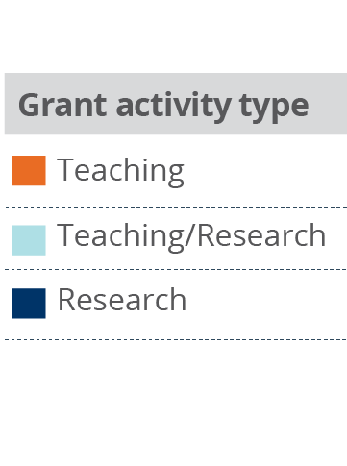
VISITING SCHOLAR PROGRAM
Core Fulbright Visiting Scholar Program
Purpose and Application
  Visiting Scholars from other countries engage in research and teaching activities on U.S. campuses
  Visiting Scholars apply through the Fulbright Commission or U.S. Embassy in their home countries
  Letters of Invitation
10%
1%
89%
Percentage
of Visiting Scholars
2016-2017

Slide 34
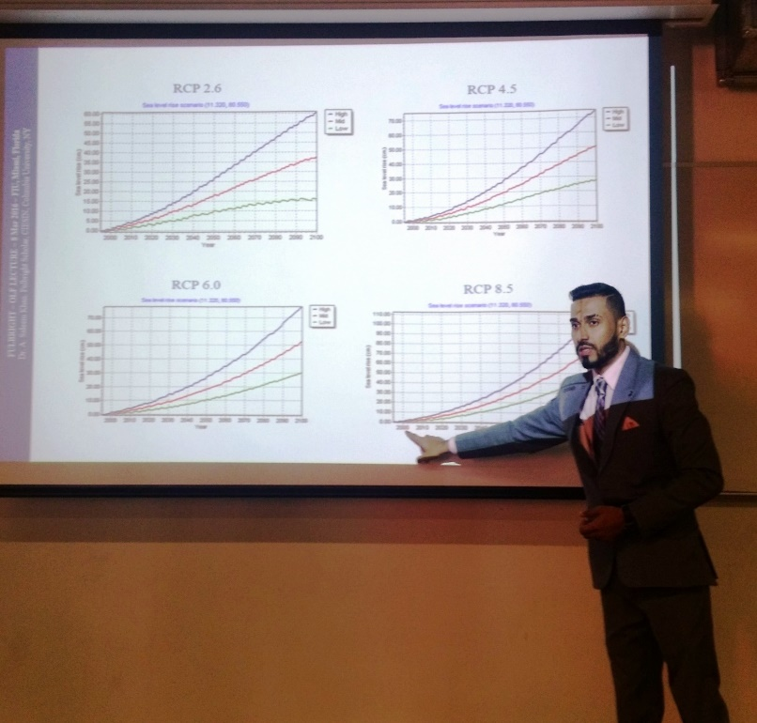
VISITING SCHOLAR PROGRAM
Core Fulbright Visiting Scholar Program
IIE/CIES
  Issues DS-2019s for the all Visiting
  Scholars and their dependents.
  Provide Scholars with J-visa
    compliant health benefits plan
  Fulbright Enrichment
  Opportunities
Host Institutions
  Access to Libraries and work space
  Exposure to student body and
  institution community
  Include scholars in on-campus cultural activities
Notes:
Photo Caption: Saleen Khan, a research associate from Chennai, India, during his 2015-2016 Fulbright Visiting Scholar Award where he conducted research at Columbia University.

Slide 35
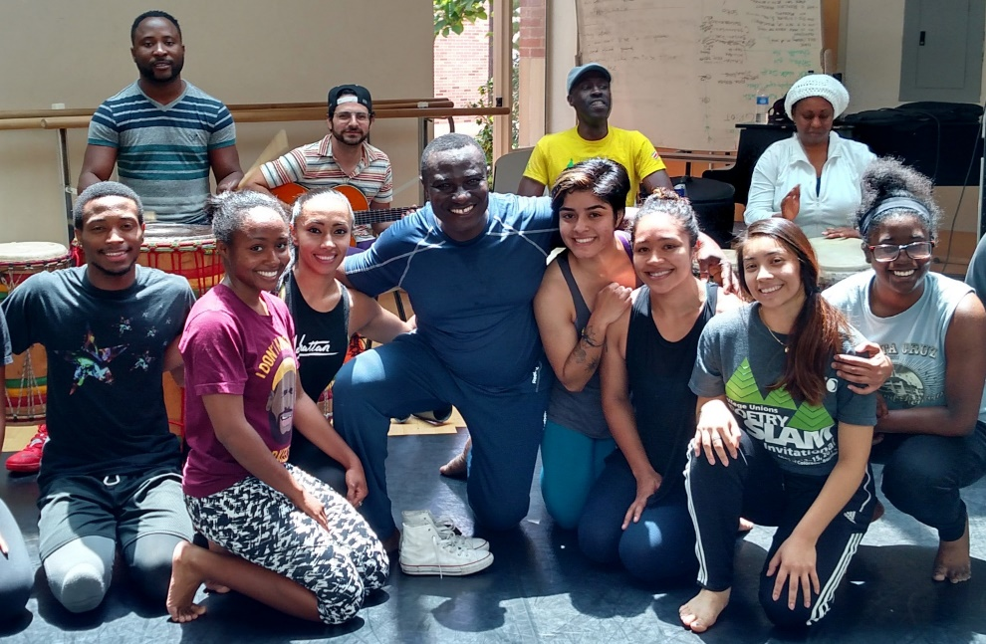
VISITING SCHOLAR PROGRAM
Scholar-In-Residence Program
Brings scholars and professionals from abroad to campuses that do not often host visiting scholars
Involves colleges and universities
that serve student populations
underrepresented in international
exchange programs
S-I-R grantees
  Primarily teach undergraduates
  Provide cross-cultural/
  international perspective
Application is made by the interested U.S. institution
  1 semester or full academic year options
Deadline is October 16; Email: sir@iie.org
Notes:
Photo Caption: Benjamin Ayettey, a dance instructor from Accra, Ghana, was a Scholar-In-Residence at Ohio Norther University from 2015-2016.

Slide 36

VISITING SCHOLAR PROGRAM
Outreach Lecturing Fund (OLF)
Travel grant for Fulbright Visiting Scholars already in the U.S. for
short-term guest teaching
Institutionally driven application
by U.S. Host Institutions
Scholars can meet, lecture and
exchange ideas with faculty and
students, community organizations,
and K-12 schools that have a special
interest in international relations and exchange ideas.
View the online scholar directory for a list of 900+ scholars who are
currently in country.
Email: olf@iie.org
Notes:
Photo Caption: Okaka Dokotum, an assistant professor of Literature and chair from Kyambogo University in Uganda, was a Fulbright Visiting Scholar at Northern Illinois University from 2014-2015. Photographed on his OLF to East Carolina University.

Slide 37
VISITING SCHOLAR PROGRAM
Faculty Development Programs
Egypt JFDP Cohort Disciplines:
  Public Health
  Renewable Energy & Engineering
  TEFL/Linguistics
Tunisia JFDP Cohort Discipline:
  Information Technology/Computer Science
Lebanon JFDP Cohort Disciplines:
  Journalism & Media
  Rural & Economic Development
  TEFL/Linguistics
Iraq Visiting Scholar Program Cohort Disciplines:
  Law & Human Rights
  Engineering
  Science & Technology
  TEFL/Linguistics
  Business Administration & Global Entrepreneurship

Slide 38
FULBRIGHT FAMILY
Other Fulbright Programs
Fulbright Specialist Program
  Short term program that promotes linkages between U.S. scholars and professionals and their counterparts at host institutions overseas.
Fulbright U.S. Student Program
  Recent graduates, postgraduate candidates through dissertation level, developing professionals and artists to study and research abroad
Fulbright Distinguished Awards in Teaching Program
  Principally for primary- and secondary-level educators
Fulbright-Hays Awards
  Faculty research, group projects and seminars in designated social sciences and humanities fields

Slide 39

NEXT STEPS
Stay Connected to the Fulbright Scholar Program
Join MyFulbright at cies2.org
Email me at ____
Contact Fulbright Scholar staff
Visit our website to learn more about the Core Fulbright U.S. Scholar Program

